Slide 1
BigData

Slide 2
What is Big Data?
Big Data refers to large and complex datasets that are difficult to process, store, or analyze using traditional data management tools.
These datasets come from multiple sources — sensors, social media, transactions, IoT devices, etc.
Big Data Architecture Components & Technologies
Storage : HDFS, Cloud Storage(AWS S3 etc)
Processing : Spark, Flink
Streaming : Kafka, Kinesis
Querying : Hive, BigQuery
Visualization : Tableau, Power BI

Slide 3
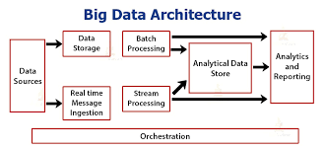

Slide 4
Big Data Architecture Components & Technologies
Category | Tools/Frameworks | Description
Storage | HDFS, Amazon S3, Google Cloud Storage | Stores massive datasets.
Processing | Hadoop, Spark, Flink, Storm | Parallel and distributed processing.
Data Ingestion | Kafka, Flume, Sqoop | Collects and moves data into storage.
NoSQL Databases | Cassandra, MongoDB, HBase | Handles unstructured/semi-structured data.
Analytics & Visualization | Power BI, Tableau, Zeppelin | Data insights and visualization.

Slide 5
Big Data Processing Types
Type | Description | Tools
Batch Processing | Processes large volumes at once (periodic). | Hadoop MapReduce, Spark Batch
Stream Processing | Processes data in real-time as it arrives. | Spark Streaming, Flink, Storm
Interactive Processing | Ad-hoc queries and real-time analytics. | Hive, Presto, Impala

Slide 6
Benefits of Big Data
Real-time analytics and forecasting.
Better & Faster Decision Making
Scalability & Flexibility
Optimized operations and cost savings.

Slide 7
Challenges in Big Data
Data security & privacy.
Integration of multiple data sources.
Managing data quality.
Lack of skilled professionals.
High infrastructure costs.

Slide 8
Data Lifecycle Stages
The Data Lifecycle represents the journey of data through different phases — from its initial creation or capture to its final deletion or archival.

Slide 9
1️⃣ Data Generation / Creation
What happens: Data is created or captured from various sources.
Sources: Sensors, transactions, IoT devices, social media, applications, surveys, etc.
Example: A user posts on Instagram
2️⃣ Data Collection / Ingestion
What happens: Data is gathered and brought into the system.
Methods: APIs, logs, forms, IoT data streams, ETL (Extract, Transform, Load).
Example: Sales data collected from multiple branches into a central database.

Slide 10
3️⃣ Data Storage
What happens: Data is stored in structured or unstructured formats.
Tools/Technologies:
Databases (SQL, NoSQL)
Data Lakes (HDFS, S3)
Data Warehouses (Snowflake, BigQuery, Redshift)
Goal: Ensure availability, scalability, and security.
4️⃣ Data Processing
What happens: Raw data is cleaned, transformed, and organized for analysis.
Techniques: Data cleaning, normalization, aggregation, and enrichment.
Tools: Apache Spark, Hadoop, ETL pipelines.
Example: Removing duplicates and formatting timestamps before analysis.

Slide 11
5️⃣ Data Analysis
What happens: Data is analyzed to extract insights and patterns.
Techniques: Statistical analysis, machine learning, data mining, visualization.
Tools: Python (Pandas, Scikit-learn), Power BI, Tableau.
Goal: Support business decisions and innovation.
6️⃣ Data Visualization & Reporting
What happens: Analytical results are represented visually.
Outputs: Dashboards, charts, reports.
Tools: Tableau, Power BI, Matplotlib, Looker.
Example: Displaying sales trends by region in a dashboard.

Slide 12
7️⃣ Data Archival
What happens: Older or less frequently used data is moved to low-cost storage.
Goal: Retain data for compliance, auditing, or future analysis.
Tools: Glacier, Azure Archive, Coldline Storage.
Example: Storing 5-year-old transaction data for legal reasons.
8️⃣ Data Deletion / Disposal
What happens: Data is permanently removed when no longer needed.
Goal: Free up storage, ensure privacy compliance (GDPR, HIPAA).
Methods: Secure deletion, anonymization, shredding backups.

Slide 13
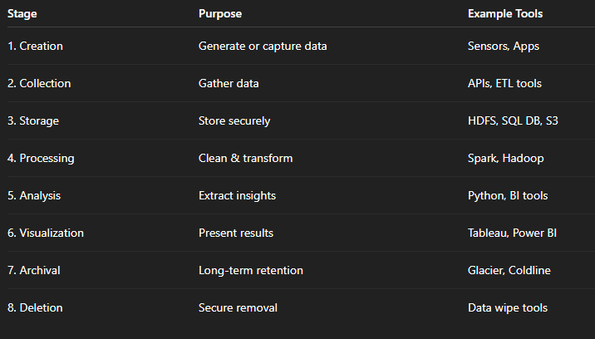

Slide 14
Types of Data
Structured
Semi structured
Unstructured

Slide 15
a. Structured Data
Definition: Data that is organized in a fixed format (rows & columns).
Storage: Relational databases (SQL, Excel).
Examples:
Customer table: Name, ID, Age, Salary
Transaction records
Tools: MySQL, Oracle, SQL Server
🧠 Easy to store, search, and analyze using SQL.

Slide 16
b. Semi-Structured Data
Definition: Data that does not follow a strict structure but has some organizational elements (tags, key-value pairs).
Storage: NoSQL databases, XML, JSON.
Examples:
JSON: { "name": "Kumar", "age": 30 }
XML, Logs, Emails
Tools: MongoDB, Cassandra, Elasticsearch
🧠 More flexible — structure can vary record by record.

Slide 17
c. Unstructured Data
Definition: Data with no predefined model or format.
Storage: Data lakes, object storage.
Examples:
Text documents
Audio, Video, Images
Social media posts
Tools: Hadoop HDFS, Amazon S3
🧠 Requires AI/ML or NLP techniques for analysis.

Slide 18
Bigdata File types

Slide 19
In Big Data systems, data is stored and exchanged in a variety of file types (formats) — each optimized for specific use cases, performance needs, and data processing frameworks.

Slide 20
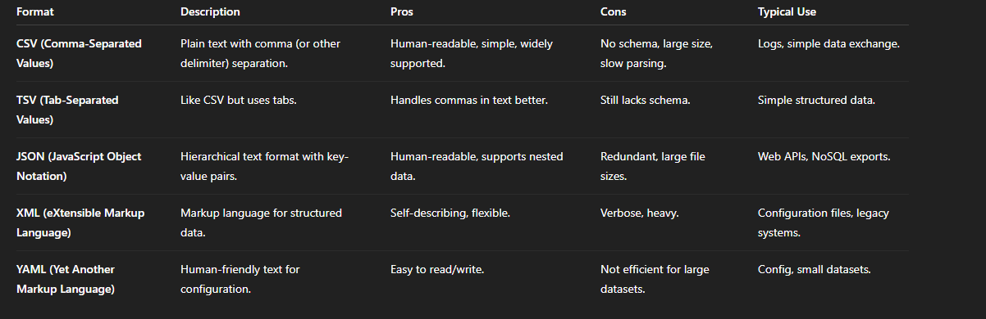
1. Text-Based Formats

Slide 21
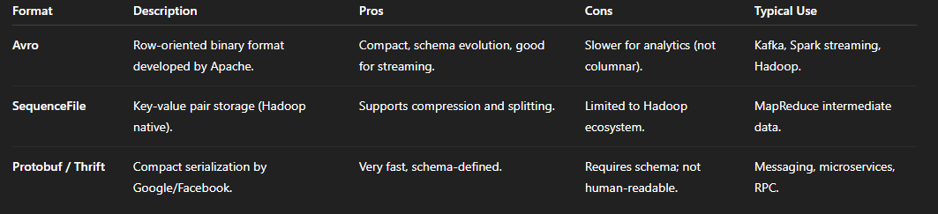
2. Binary Row-Based Formats

Slide 22
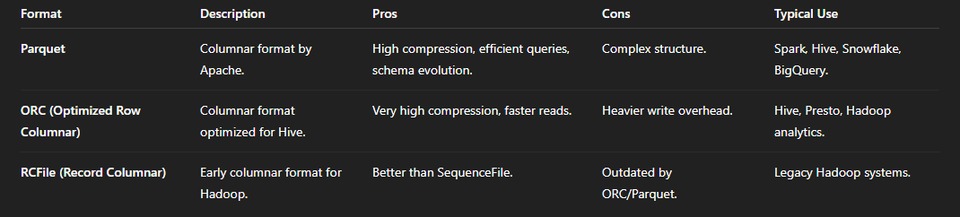
3. Columnar Formats (for analytical workloads)

Slide 23
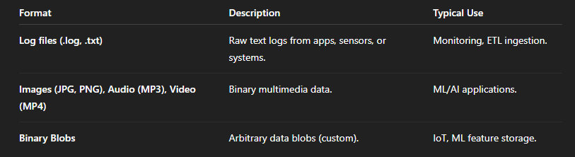
4. Semi-Structured and Unstructured Formats

Slide 24
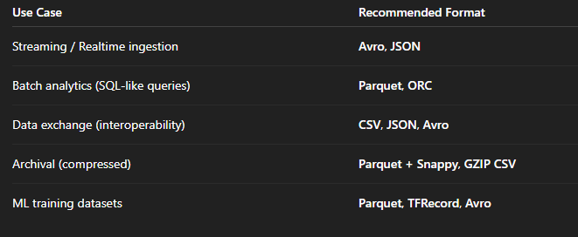
File Format Selection Guidelines

